Slide 1
Lab Exercise 1
CSDC102: Intermediate Programming

Slide 2
Before your codes...
//******************************************************************
// Filename :
// Date :
// Subject :
// Second Semester, SY 2019 - 2020
// Activity : Lab 1A
// Problem Title :
// Input :
// Output :
//
// Honor Code : *insert honor code here*
//
// Complete Name :
// ID Number :
// Year-Course : 1-BSCS
// DCS, College of Computer Studies
// Ateneo de Naga University
//******************************************************************

Slide 3
Honor Code : This is my own program. I have not received any
unauthorized help in completing this work. I have not
copied from my classmate, friend, nor any unauthorized
resource. I am well aware of the policies stipulated
in the handbook regarding academic dishonesty.
If proven guilty, I won't be credited any points for
this exercise.

Slide 4
Lab 1A: Arithmetic Operators
Program Description:
Your task is to write a code that asks the user to enter amount in peso.
You may assume the user will input a positive whole number
The code then will output the number of Php1000 bill, Php500 bill, Php200 bill, Php100 bill, Php50 bill, Php20 bill, Php10 coin, Php5 coin and Php1 coin.
Filename: Lab1A_SURNAME.cpp

Slide 5
Lab 1A: Arithmetic Operators
Specifications:
Implement using Functions

Slide 6
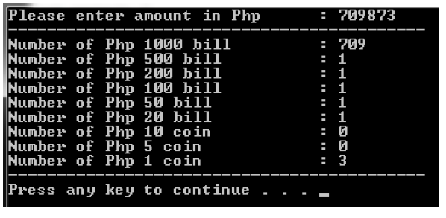
Lab 1A: Arithmetic Operators
The program output should look like this:

Slide 7
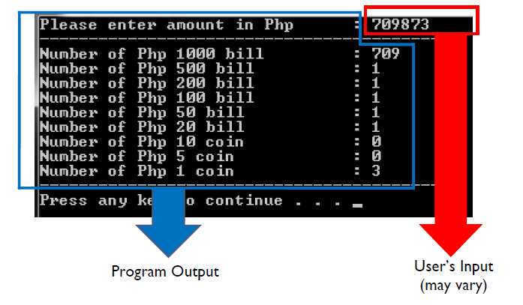
Lab 1A: Arithmetic Operators
The program output should look like this:

Slide 8
Lab 1B: Strings
Program Description:
Create a program that will accept a string LANGUAGE and string WORD from the user. Then, identify whether the WORD is a valid string from a LANGUAGE.
If the WORD is valid, display WORD , Welcome Kalahi! . Otherwise, WORD , Ho u?!.
Filename: Lab1B_SURNAME.cpp

Slide 9
Lab 2b: Strings
Specifications:
Implement using Functions

Slide 10
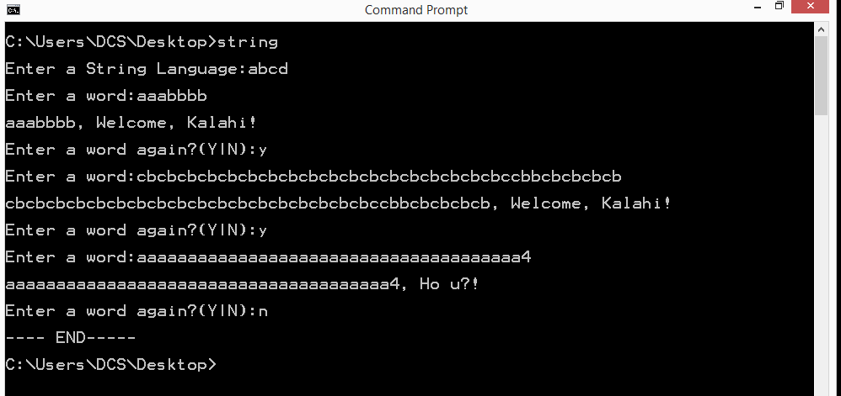
Lab 2b: Strings
The program output should look like this:

Slide 11
Lab 1C: 2D Arrays
Program Description:
Asks the user to enter the number of rows and the number of columns
Display a table where each cell corresponds to the product of the row value and column value
The first line should display a welcome message with the following format:
“Welcome to <Your First Name> ’s Multiplication Table Creator!”

Slide 12
Lab 1C: 2D Arrays
Specifications:
The multiplication table must be stored in array of integers named mulTable which can hold a maximum of 100 integers in row and column.
A void function named CreateMulTable which takes 3 parameters - name_Table of type int[100][100] , row_size_mulTable of type int (from user input), and col_size_mulTable of type int (from user input). This function will create the multiplication table ( row_size_mulTable x col_size_mulTable size) and store the results in name_Table array.

Slide 13
Lab 1C: 2D Arrays
Specifications:
A void function named print which takes takes 3 parameters - name_Table of type int[row][col], row_size_mulTable of type int (from user input), and col_size_mulTable of type int (from user input). This function display a row_size_mulTable x col_size_mulTable size multiplication table in the screen.

Slide 14
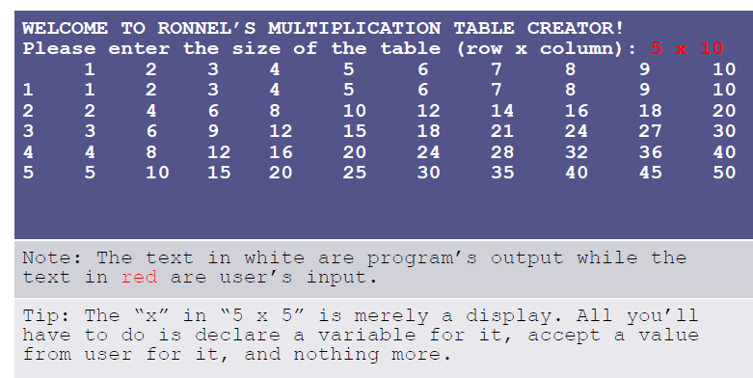
Lab 1C: 2D Arrays
The program output should look like this:

Slide 15
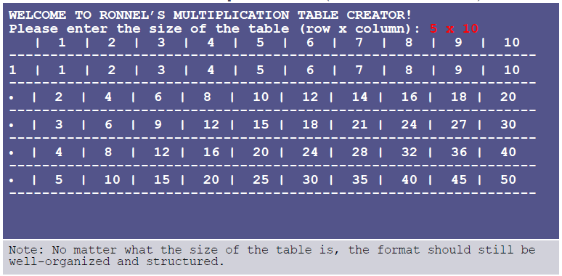
Lab 1C: 2D Arrays
Sample output with +10 bonus points

